Slide 1
An Introduction to Neural Networks
Nick Jathar
December 2021

Slide 2
Roadmap
Introduce the business problem
Build basic intuition

Slide 3




The Business Problem
A bank wants to design a process that will help it determine whether to grant or reject loans.
The primary concern for the bank is if a company will stay in business or go bankrupt.
The bank will grant loans to companies it believes will stay in business.
The bank will reject loans for companies it believes will go bankrupt.
Believes company will stay in business
Company applies for a loan
Believes company will go bankrupt
Introducing the Business Problem

Slide 4
Inputs to the Process
The bank wants to have a simple loan approval / rejection process (process).
The bank has data on 40 companies that applied for loans in the past.
This data contains the following information for each company:
How much Debt the company held when it applied for the loan.
How much Assets the company had when it applied for the loan.
Whether the company stayed in business or went bankrupt within a year of receiving the loan from the bank.
The bank will use only this data to develop the process.
Introducing the Business Problem

Slide 5
Visualizing the Inputs and Outcomes
The chart encodes for all three variables in the data:
Debt is shown on the x-axis.
Assets are shown on the y-axis.
Companies that stayed in business are encoded as green dots.
Companies that went bankrupt are encoded as red dots.
This data makes sense from a business perspective.
Introducing the Business Problem

Slide 6
Creating a Simple and Intuitive Process
The initial process will use only basic arithmetic and simple logic:
The two inputs (Debt and Assets) will be used to predict the bankruptcy outcome (label).
A prediction of 0 (zero) means that the process believes the company will stay in business.
A prediction of 1 means that the process believes the company will go bankrupt.
The initial process:
For a given company add its Debt and Assets together.
If this sum is less than $405 predict 0 for bankruptcy.
If this sum is greater than or equal to $405 predict 1 for bankruptcy.
Notice that if this process is applied to the bank’s data, the predicted outcome matches what actually happened perfectly.
Next, let’s convert this wordy process into a picture.
Building basic intuition

Slide 7
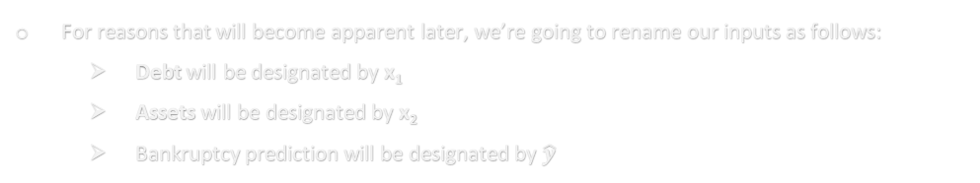
Developing a Picture of the Initial Process
The initial process:
For a given company add its Debt and Assets together.
If this sum is less than $405 predict 0 for bankruptcy.
If this sum is greater than or equal to $405 predict 1 for bankruptcy.
For reasons that will become apparent later, we’re going to rename our inputs as follows:
Debt will be designated by x₁
Assets will be designated by x₂
Bankruptcy prediction will be designated by $\hat{y}$
x₁
1
x₁ + x₂
x₂
0
x₁ + x₂
380
390
400
410
420
430
18
19
20
21
22
23
Building basic intuition

Slide 8
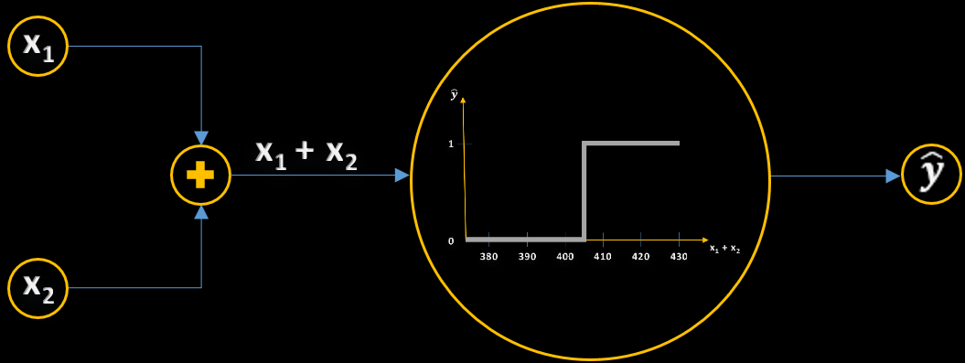
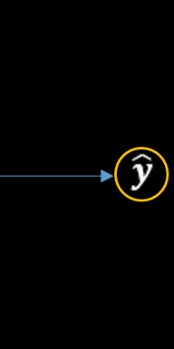
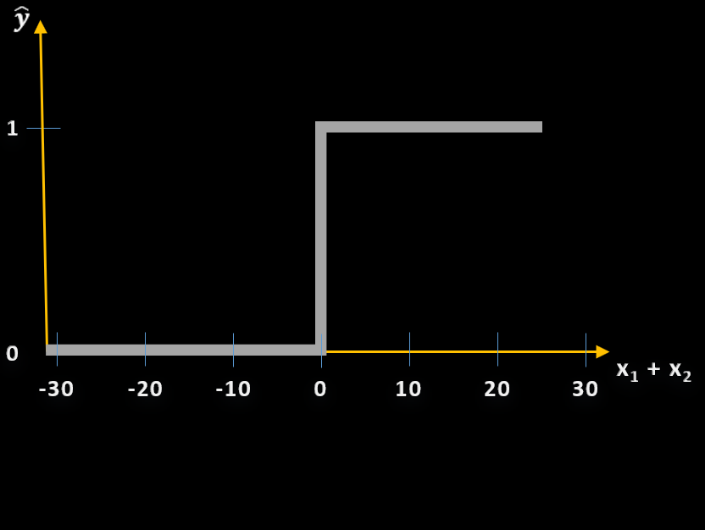


Upgrading the Initial Process
SECOND UPGRADE → Adding a bias term
VOCABULARY CHECKLIST
THIRD UPGRADE → Gauging Process Performance Using Error
FIRST UPGRADE → Adding weights to the process
Inputs
Label (outcome)
Prediction
1
1
405
Actual label
Predicted label
What values of w₁, w₂, and b₁ ensure equivalence?
Propagation
Forward propagation
Shifting the Heaviside function necessitated the introduction of a bias term in order to maintain equivalence between our upgraded process and our original process.
Weights
x₁
Activation Function
x₁
Heaviside function
Bias
If w₁ is set to a weight of 1, then the weighted input w₁x₁ is identical to the original input x₁.
Error
MATH CHECKLIST
x₁
x₁
Simple arithmetic
Simple logic
w₁x₁
-y
By shifting our original step function to the left, we have changed our logical test for the bankruptcy prediction. What happens if we plug w₁x₁ + w₂x₂ into this activation function? (For now, keep it simple and set w₁ and w₂ to 1)
w₁
This step function anchored at 0 is called an activation function. The step function, a.k.a. the Heaviside function creates challenges that we’ll tackle in due time. But we’ll stick with it for now because of its intuitive appeal.
w₁
-1
$$\left|\hat{y}−y\right|$$
w₁x₁ + w₂x₂
w₁x₁ + w₂x₂ - b₁
1
$$Error$$
b₁
x₂
x₂
The activation function will predict that all 41 companies in our data will go bankrupt.
w₂x₂
We want to move this step-function to the left so that it steps up at x₁ + x₂ = 0.
We’ll apply the same weighting concept to input x₂.
w₂
We need to fix this situation. To do so, we’ll introduce the concept of bias.
w₂
0
x₁ + x₂
-30
-20
-10
0
10
20
380
30
390
400
410
420
430
Building basic intuition

Slide 11

Adding more functionality to the initial process
VOCABULARY CHECKLIST
Inputs
Label (outcome)
Prediction
Actual label
Predicted label
Propagation
Forward propagation
$$\hat{y}−y$$
MATH CHECKLIST
Simple arithmetic
Simple logic
-y
Building basic intuition

Slide 12
The Business Problem We Want To Solve
Before we look at the business problem, let’s define the business and its constraints
The fund makes investments strictly using fundamental analysis
Any quantitative methods used are applied only on inputs to fundamental analysis
Machine Learning (ML) and Quantitative Method Analogs (QMA) are not drivers for putting capital to work
The fund’s opportunity set is limited by the cumulative expertise of the fund’s analysts
Business factors create pressures that tend to shrink the opportunity set

Slide 13
Roadmap
Basics
Propogation
Activation Functions
Perceptron
The Math of Forward Propogation
Why Do We Need Activation Functions
Weights in a Perceptron
The Math of Backward Propogation
Linear
Sigmoid
Tanh
Multi-Layer Perceptron
Backward Propogation in Matrix Form
ReLU
Leaky ReLU
Softmax
Forward and Backward Propogation
NN from Scratch Using Numpy
Selecting the Right Activation Function
Gradient Descent Algorithm
Forward Propogation Using Numpy
Backward Propogation Using Numpy
Training NN Using Numpy
Optimizers
Variants of Gradient Decsent
Visualizing a Neural Network
Why Numpy?
Understanding Decision Boundaries
Problems with Gradient Decsent
RMSProp
Adam
Loss Functions
Introduction to Loss Functions
Binary and Categorical Cross Entropy / Log Loss

